Slide 1
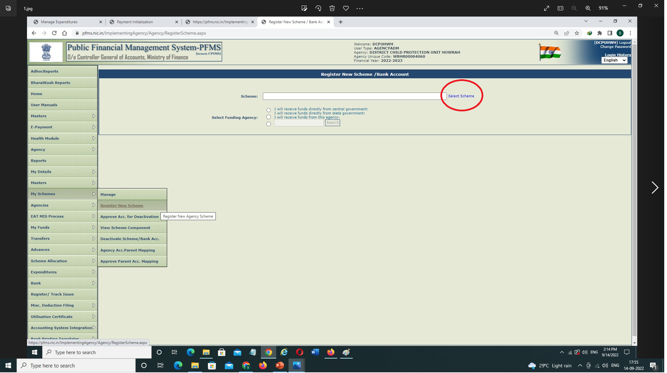
Registration of Holding Account
Login with Agency Admin → My Schemes → Register New Scheme→ click on select scheme →

Slide 2
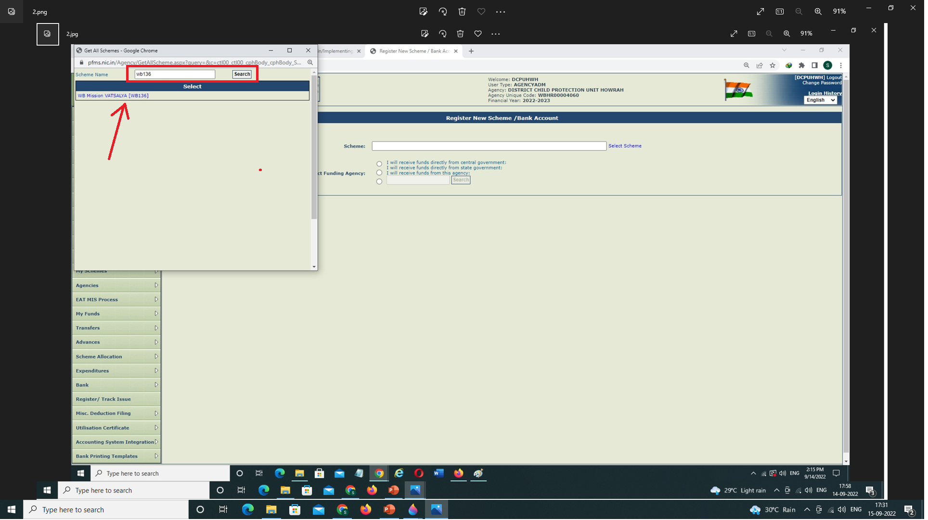
Registration of Holding Account – contd.
Enter your Scheme Code & click on search → then the Scheme name will appear on screen, select the Scheme →

Slide 3
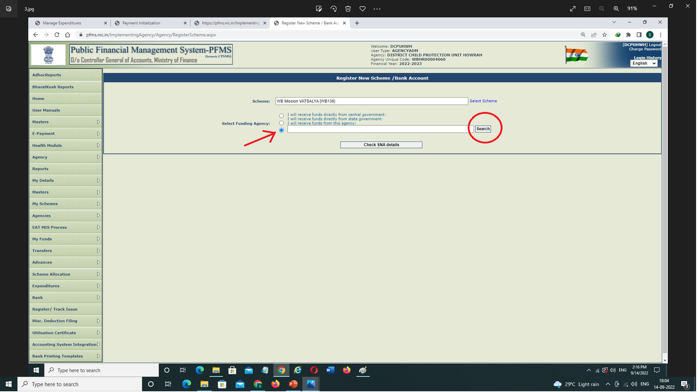
Registration of Holding Account – contd.
Select appropriate Funding Level Agency as "I will receive funds from this agency“ (Only for SNA, Funding Level will be the State Government) then click on search →

Slide 4
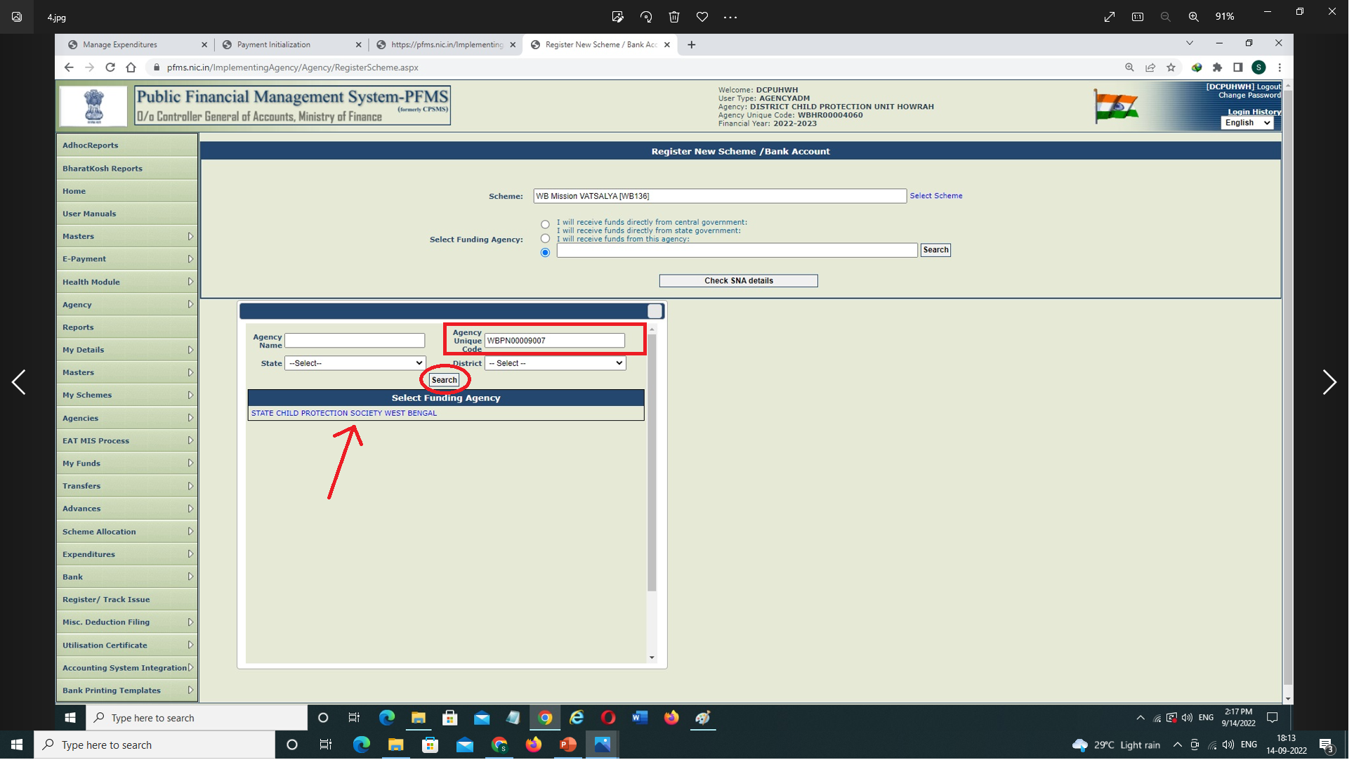
Registration of Holding Account – contd.
A Pop-up Table will appear, Enter Parent Level’s Unique Agency Code then click on search your Parent Level will appear, select the same →

Slide 5
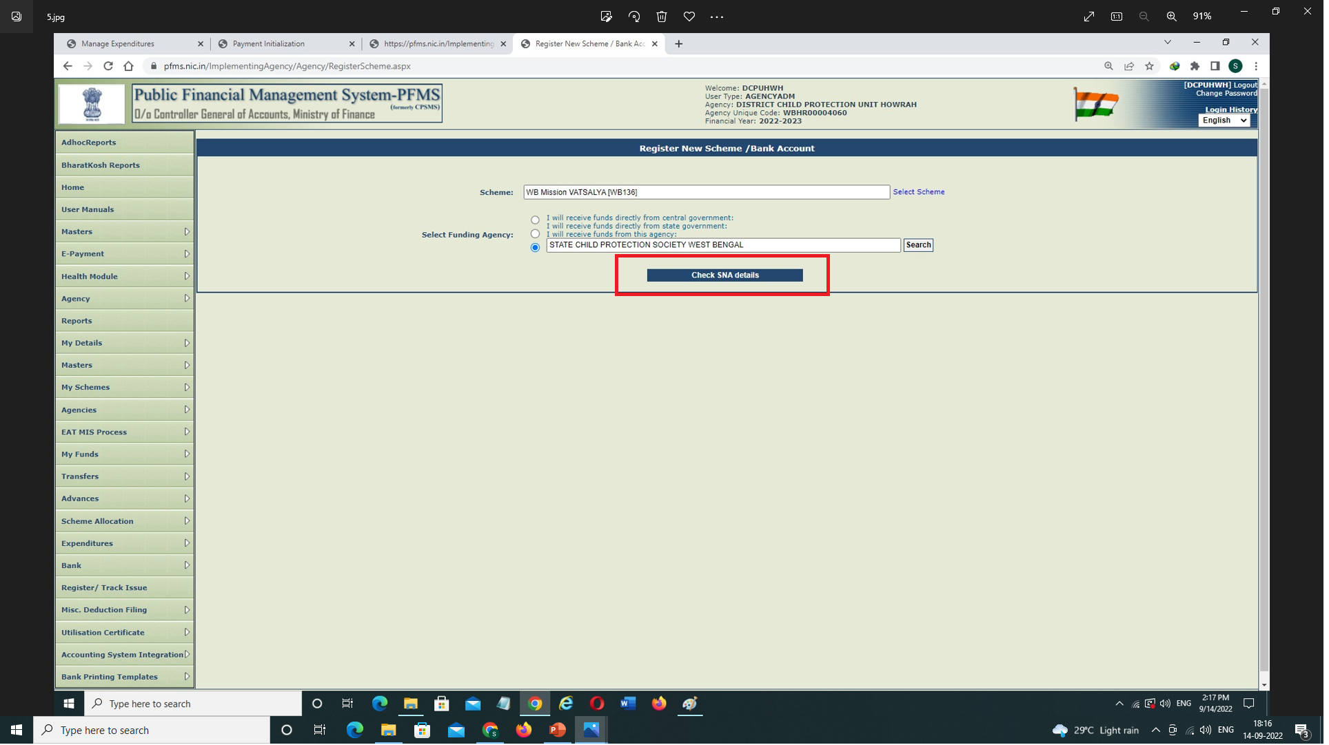
Registration of Holding Account – contd.
Click on Check SNA details →

Slide 6
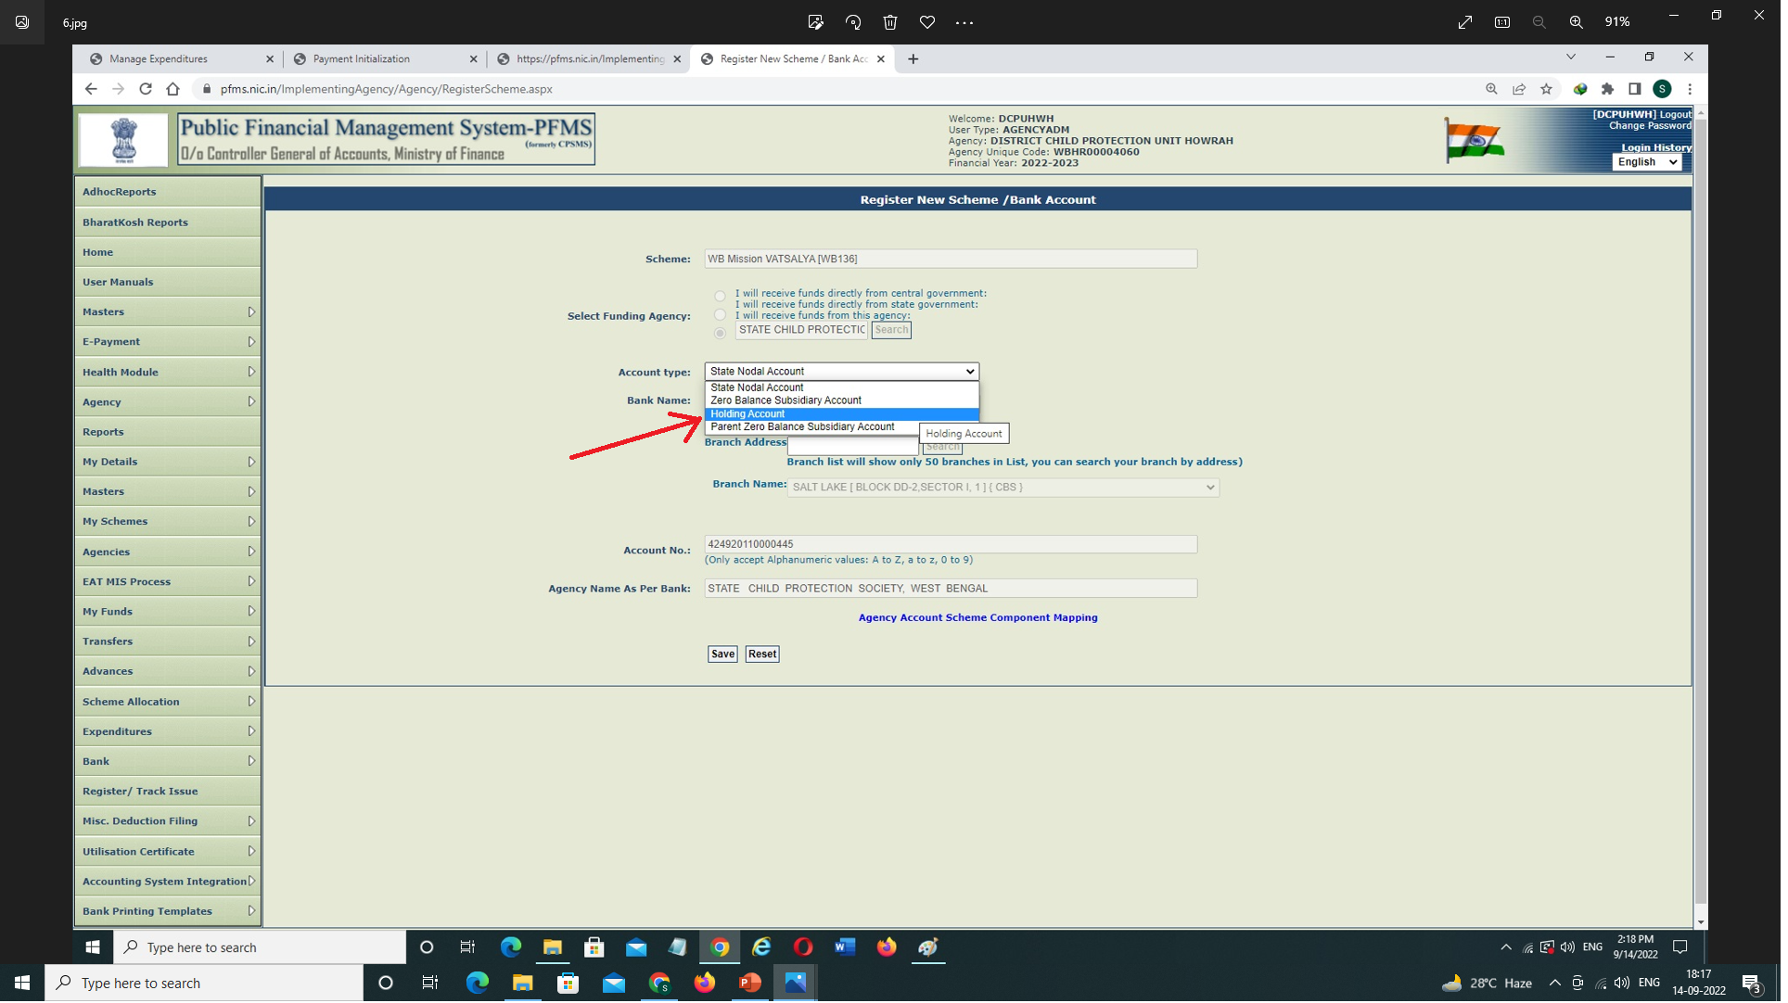
Registration of Holding Account – contd.
Select ‘Holding Account’ from the dropdown of ‘Account Type’ →

Slide 7
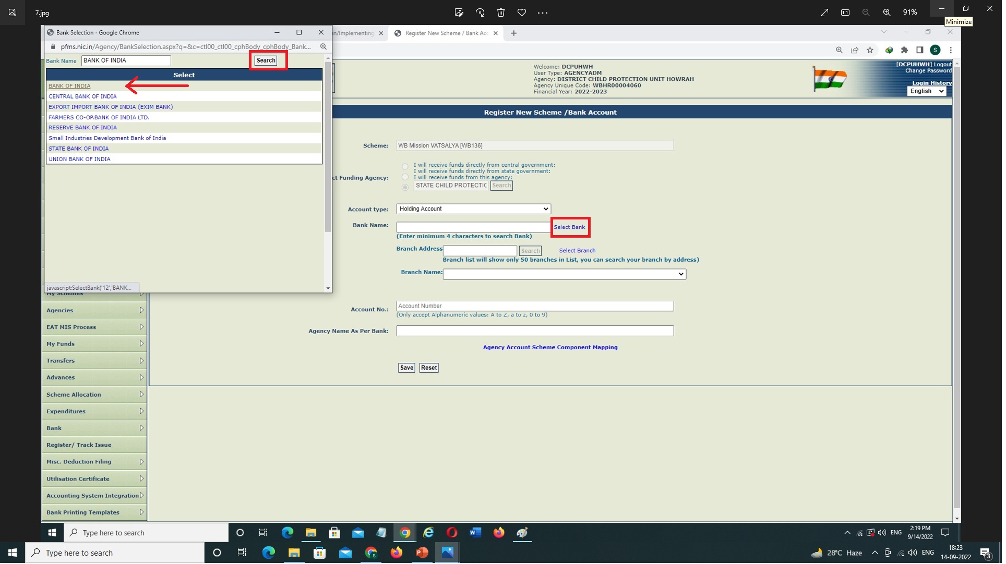
Registration of Holding Account – contd.
Click on Select Bank, a pop-up table will appear → Enter the Bank Name & Search → The Bank Name will be Displayed → Select the same →

Slide 8
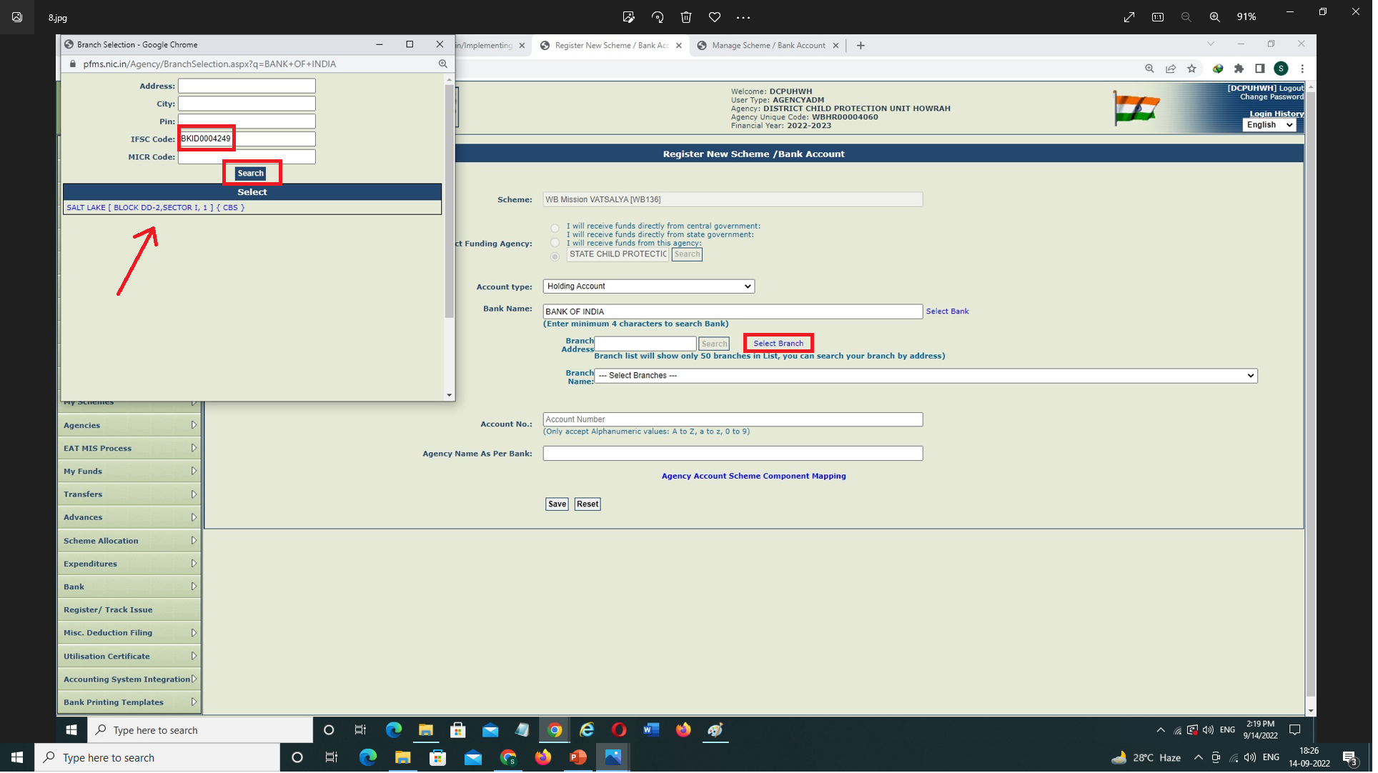
Registration of Holding Account – contd.
Click on ‘Select Branch’, a pop-up Table will appear. Enter the Bank IFSC Code & Search → Branch Address will be displayed → Select the same →

Slide 9
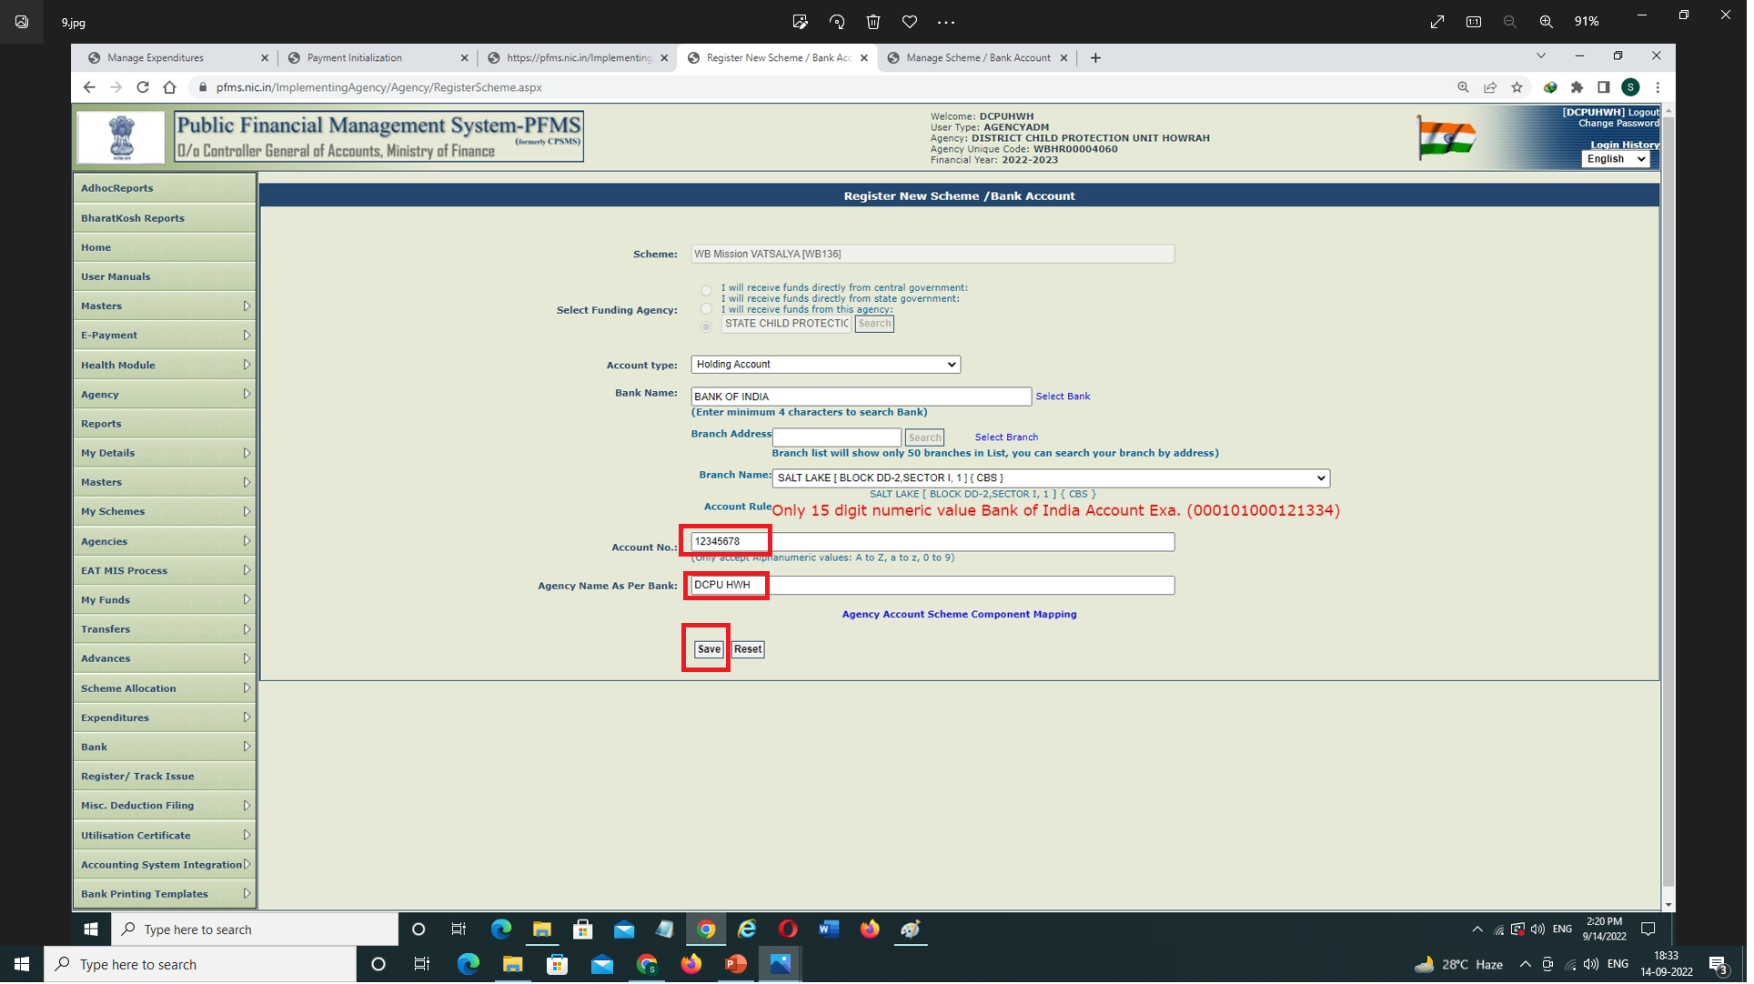
Registration of Holding Account – contd.
Enter the ‘Bank Account No.’ & ‘Agency Name as per Bank’ → Then ‘Save’

Slide 10
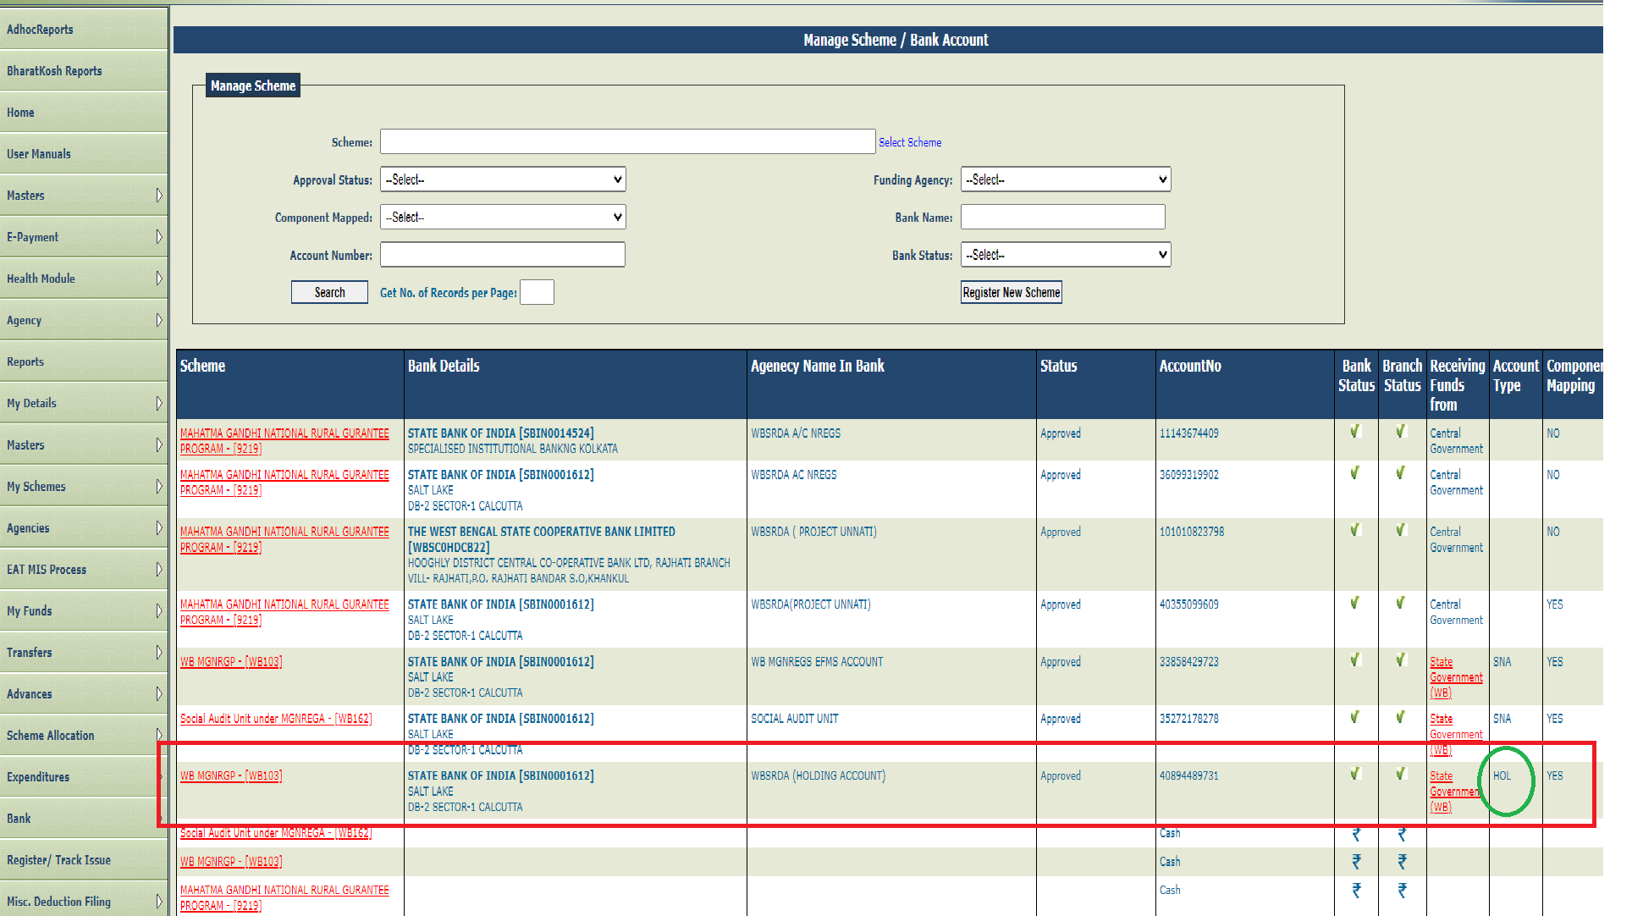
Registration of Holding Account – concld.
The Entry will be shown in My schemes → Manage (confirm that the ‘Account type’ column showing as ‘HOL’), then wait for Bank validation. Subsequent to Bank validation, approach the Parent Level Agency for approval.
After Bank validation Parent Level have to approve it by logging with their Admin ID → Agencies → Approve → then Approve that particular Entry.

